Slide 1
Upgrading 2 Python

Slide 2
TABLE OF CONTENTS
01
04
Fungsi
Pass By Reference
02
05
Return
Arbitary Arguments
03
06
Arguments
Keyword Arguments
07
08
Lambda
Method

Slide 3

Fungsi
A function is a block of code which only runs when it is called.
You can pass data, known as parameters, into a function.
A function can return data as a result.

Slide 4
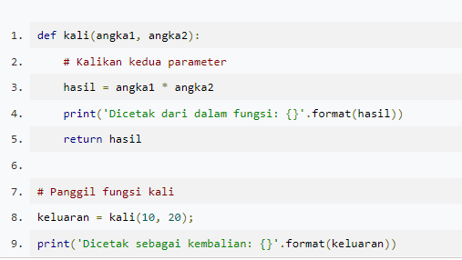
Return
Return value from function

Slide 5
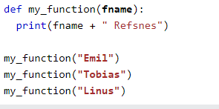
Arguments
Arguments are specified after the function name, inside the parentheses. You can add as many arguments as you want, just separate them with a comma.

Slide 6
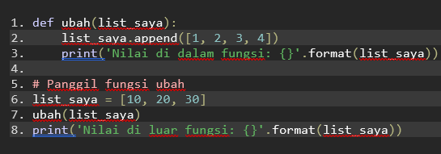
Pass by reference vs value
Seluruh parameter (argumen) pada bahasa Python bersifat “passed by reference”. Artinya saat Anda mengubah sebuah variabel, maka data yang mereferensi padanya juga akan berubah, baik di dalam fungsi, maupun di luar fungsi pemanggil. Kecuali jika anda melakukan operasi assignment yang akan mengubah reference parameter.

Slide 7

Arbitrary Arguments, *args
If you do not know how many arguments that will be passed into your function, add a * before the parameter name in the function definition.

Slide 8
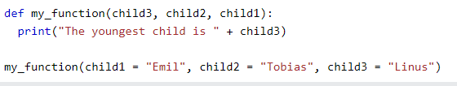
Keyword Arguments
You can also send arguments with the key = value syntax.
This way the order of the arguments does not matter

Slide 9

Python Lambda
A lambda function is a small anonymous function.
A lambda function can take any number of arguments, but can only have one expression.

Slide 10
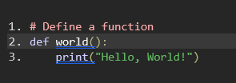
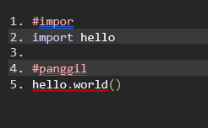
Method
Module Python adalah berkas teks berekstensi .py yang berisikan kode Python

Slide 11
Resources
Dicoding python programming
W3 School Python
Thanks to Slide Go

